Slide 1
Polymorphism in JAVA

Slide 2
Polymorphism
Polymorphism is the ability of an object to take more than one forms
An important OOP concept which is common to all OOP languages
But implementations varies from one OOP language to another
Allows multiple objects of different sub-classes
To be treated as objects of a single parent class
While automatically selecting the proper methods to apply to an object based on the child class it belongs
Simply, a concept by which a single action performed in different ways

Slide 3
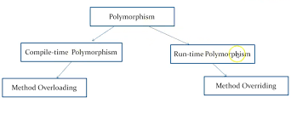
Types of Polymorphism
In JAVA, Polymorphism is of two types
Compile-time polymorphism (Static binding)
Achieved by Method Overloading
Run-time polymorphism (Dynamic binding)
Achieved by Method Overriding

Slide 4
Compile-time Polymorphism
Compile-time polymorphism (or static binding) is so called because
JAVA knows which method to invoke
By checking the method signatures at compile time
Can be achieved by
Method Overloading
If a class has multiple methods
Having the same name but different in parameters

Slide 5
Example of Method Overloading
class Add_nums
{
public int add (int a, int b)
{
return a + b;
}
public int add (int a, int b, int c)
{
return a + b + c;
}
public double add (double a, double b)
{
return a + b;
}
}
public Class Overloading_example
{
public static void main(String[] args)
{
Add_nums ad = new Add_nums();
System.out.println(ad.add (11, 11));
System.out.println(ad.add (11, 11,11));
System.out.println(ad.add (11.5, 11.2));
}
}
Output ::
22
33
22.7

Slide 6
Run-time Polymorphism
Run-time polymorphism (or Dynamic binding) is so called because
The call to a overridden method is resolved at run-time
Can be achieved by
Method Overriding
If sub-class has a method
With the same signature as declared in the parent class
When an overridden method is called through a super-class reference
JAVA determines which version (super-class / sub-classes)
of that method is to be executed based upon the type of the
object being referred to at the time of call

Slide 7
Method Overriding
Method overriding is
One way to achieve Run-time Polymorphism
Declaring a method in sub-class which is already present in parent class
Allows a sub-class to provide a specific implementation
The version of a method that is executed will be determined by the object that is used to invoke it
If an object of a parent class is used to invoke the method, then the version in the parent class will be executed
If an object of the sub-class is used to invoke the method, then the version in the sub-class will be executed

Slide 8
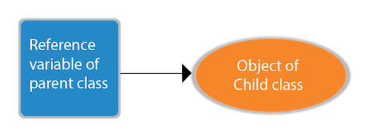
Method Overriding
If the reference variable of Parent class refers to
The object of Child class, it is known as upcasting

Slide 9
Example of Method Overriding
class Parent { // private methods are not overridden private void m1() { System.out.println(“Parent m1( )"); } protected void m2() { System.out.println(“Parent m2( )"); } } | class Child extends Parent { // The new m1() method unique to Child class private void m1() { System.out.println(“Child m1( )"); } // overriding method with more accessibility @Override public void m2() { System.out.println(“Child m2( )"); } }
class Method_Overriding { public static void main(String[] args) { Parent obj1 = new Parent(); obj1.m2(); Parent obj2 = new Child(); obj2.m2(); } } | Output :: Parent m2( ) Child m2()

Slide 10
Rules for Method Overriding
The data types of the arguments and their sequence of the overriding method should exactly match the Overridden method
Access Modifier of the overriding method in the sub-class cannot be more restrictive than the overridden method of parent class
The overriding method must have same return type as the overridden method
Private, Static and Final methods cannot be overridden as they are local to the class
Overriding method can throw unchecked exceptions regardless of whether the overridden method throws any exception or not
However, the overriding method should not throw checked exceptions that are new or broader than the ones declared by the overridden method

Slide 11
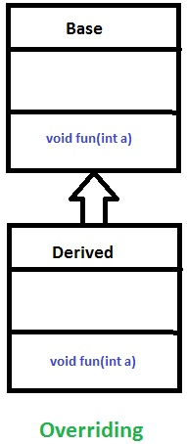
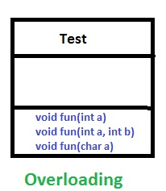
Overloading Vs. Overriding

Slide 12
Abstraction in JAVA

Slide 13
Abstraction
Abstraction is a process of
- Hiding the implementation details (internal details)
- Showing only functionality (essential things) to the user
Abstraction lets us to focus on
- What the object does instead of how it does it
In JAVA
- Two ways to achieve abstraction
Interface
Abstract class

Slide 14
Abstract Class and Methods
Abstract Class
Must be declared with an abstract keyword
Cannot be instantiated
Can have abstract and non-abstract methods
Can have constructors and static methods also
Can have final methods
Forces the sub-class not to change the body of the method
Abstract Method
Declared as abstract
Does not have implementation

Slide 15
Example of Abstraction
abstract class Shape { abstract void draw( ); } class Rectangle extends Shape { void draw ( ) { System.out.println (“Rectangle"); } } class Circle extends Shape { void draw ( ) { System.out.println (“Circle"); } } | class Abstraction { public static void main ( String args[] ) { Shape s; s = new Circle ( ); s.draw ( ); s = new Rectangle(); s.draw(); } }
 | Output :: Circle Rectangle

Slide 16
Abstract Class Vs. Interface
Abstract class | Interface
The abstract keyword is used | The interface keyword is used
An abstract class can be extended using keyword "extends" | An interface can be implemented using keyword "implements"
Can have abstract and non-abstract methods | Can have only abstract methods
Can have final, non-final, static and non-static variables | Can have only static and final variables
Can provide the implementation of interface | Can't provide the implementation of abstract class
Members may be public, private, protected, etc. | Members are public by default
Example: public abstract class Shape { public abstract void draw(); } | Example: public interface Drawable { void draw(); }

